Slide 1
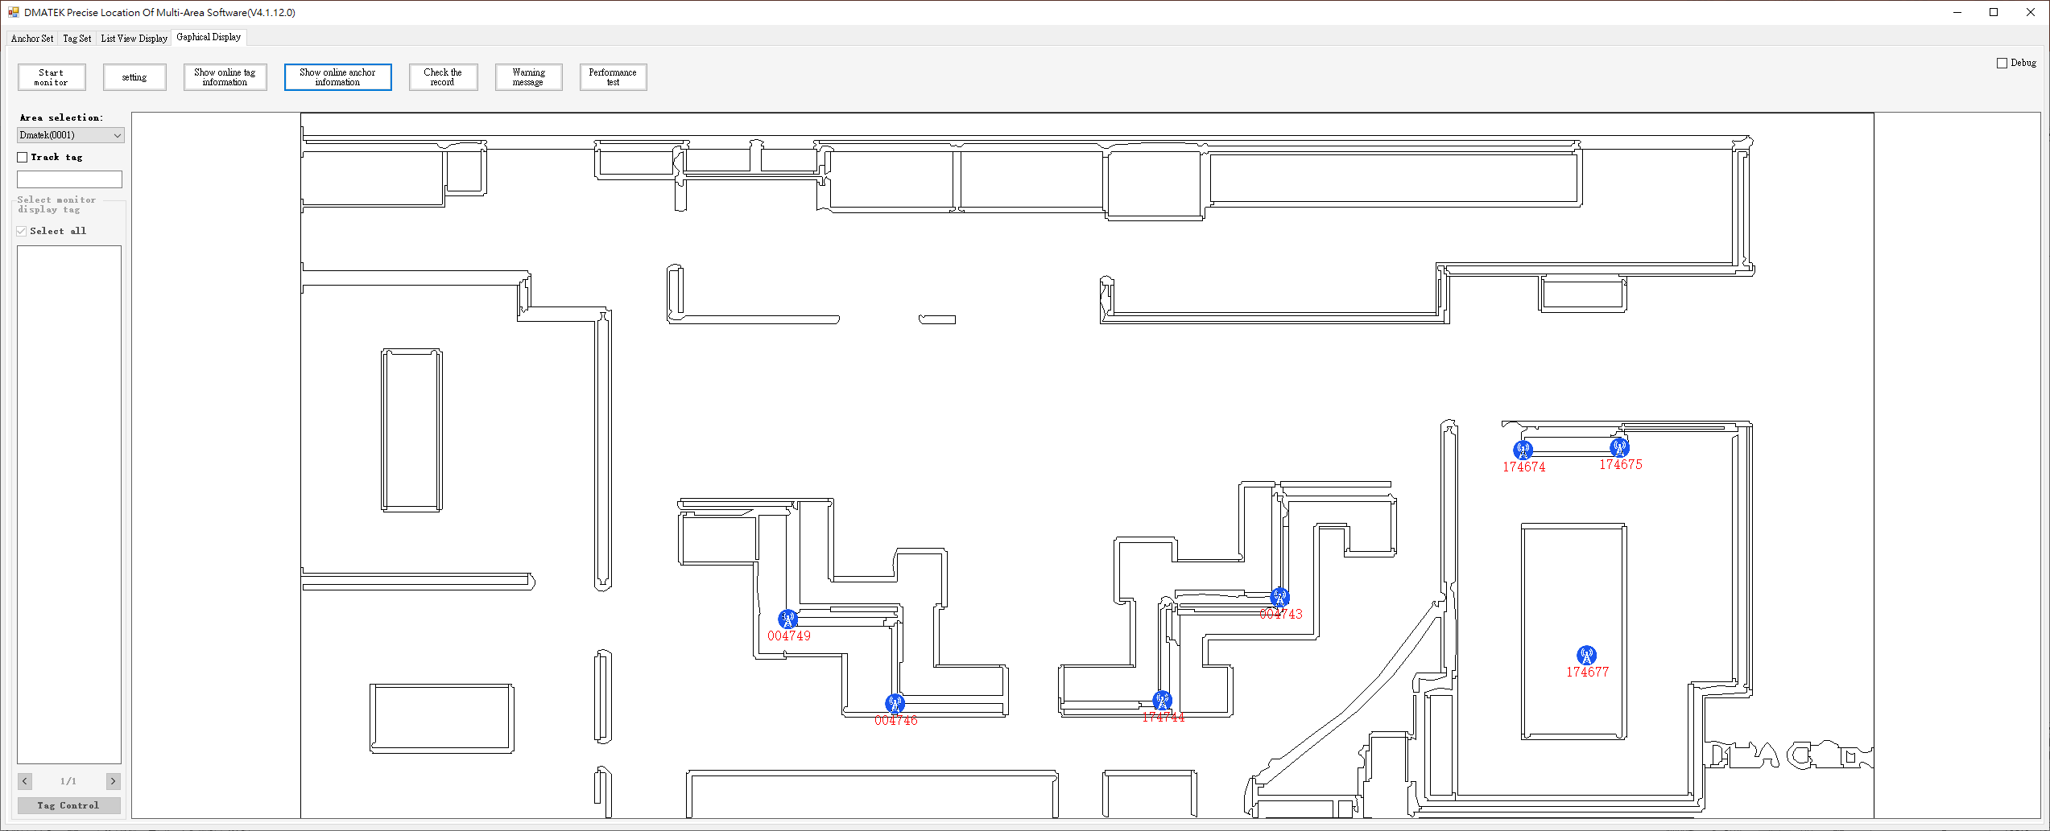
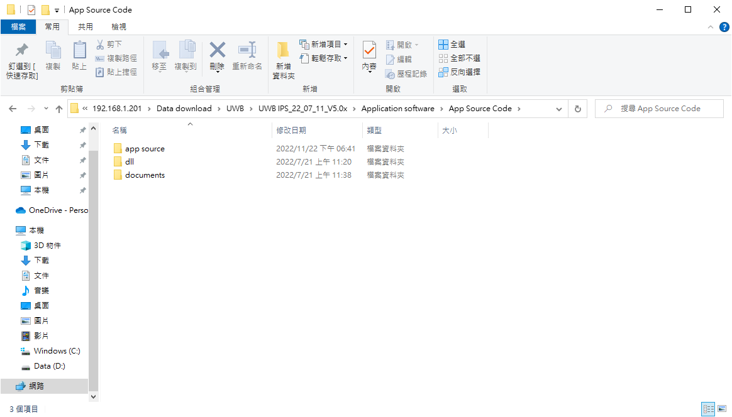
IPS Function
Execution Environment
Winodows System
Portable Application
Main Function
IPS UDP Packet Monitoring
Real-time Location Display
Warning Information
Device Control (LED, buzzer, vibration motor)
Restricted Area
Historical Record
Source Code
C# project source code
Secondary Development
Communication protocol and packet format
C# project source code
.net V4.0 C# dll, contains positioning algorithm, does not provide source code (Windows environment development)
.net V5.0 C# dll, contains positioning algorithm, does not provide source code (Cross-platform development available, optional)
Usage Restrictions
Unlimited

Slide 2
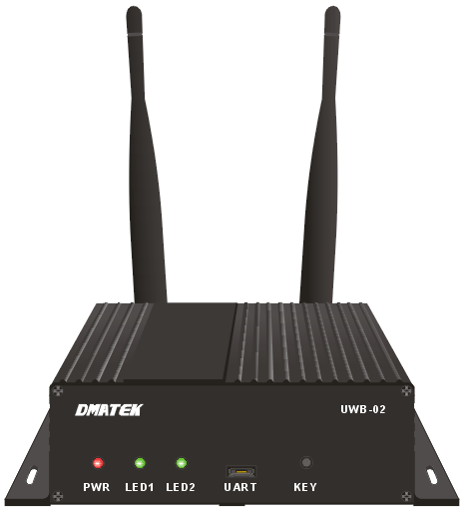
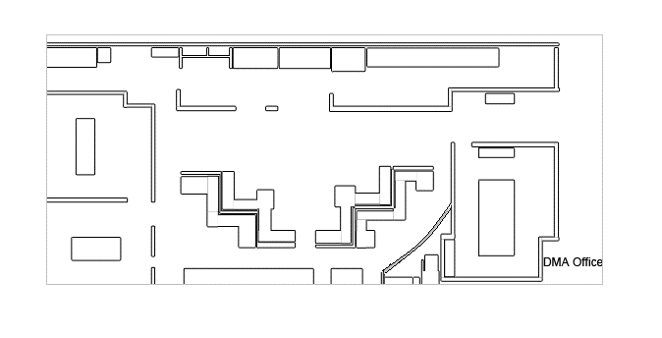
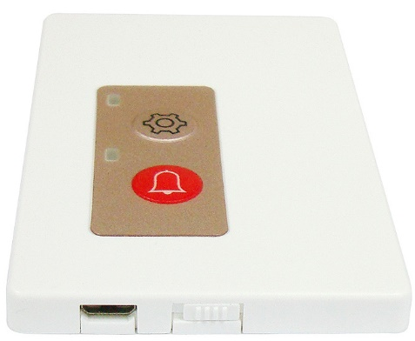
IPS Architecture
Third-party positioning web application development
UWB IPS
Using Dll
Portable Application
main program
Real-time Location Display
Warning Information
Device Control
Restricted Area
Historical Record
LAN
POE
WIFI
Get distance (TOF)
Equipment control
Firmware update
Parameter update
IPS dll
Packet Monitoring
Tag Coordinate Calculation
Positioning Information Processing
Device Control
Report packet
Control packet
Update package
Internet

Slide 3
Positioning Web Display

Slide 4
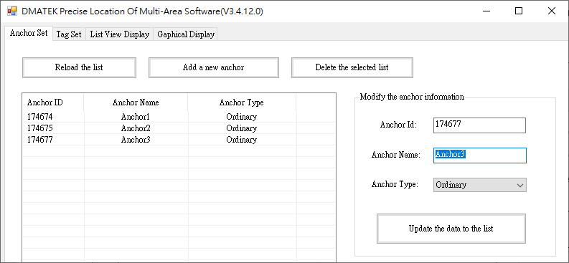
Anchor Set

Slide 5
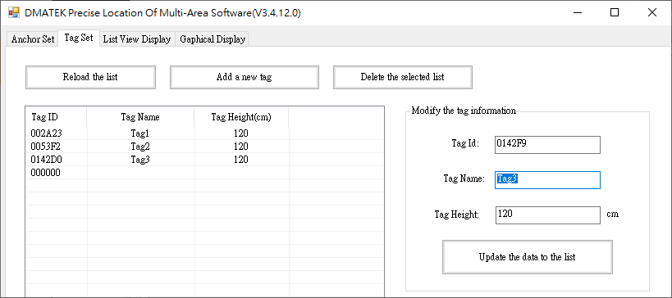
Tag Set

Slide 6
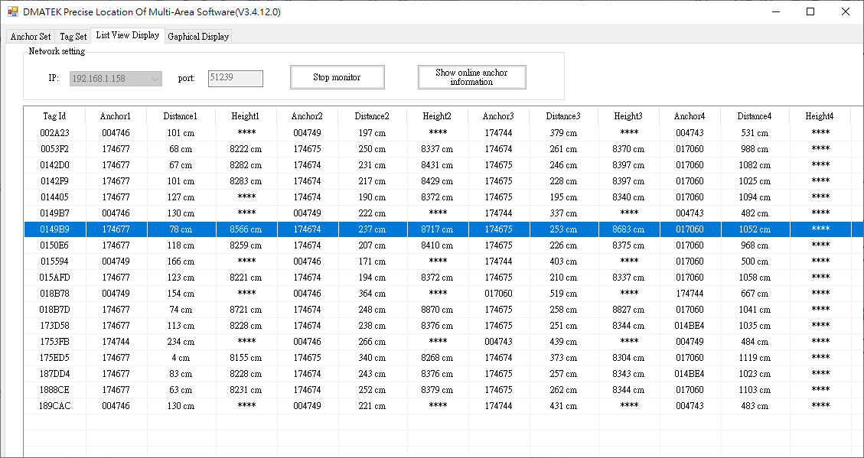
List View Display

Slide 7
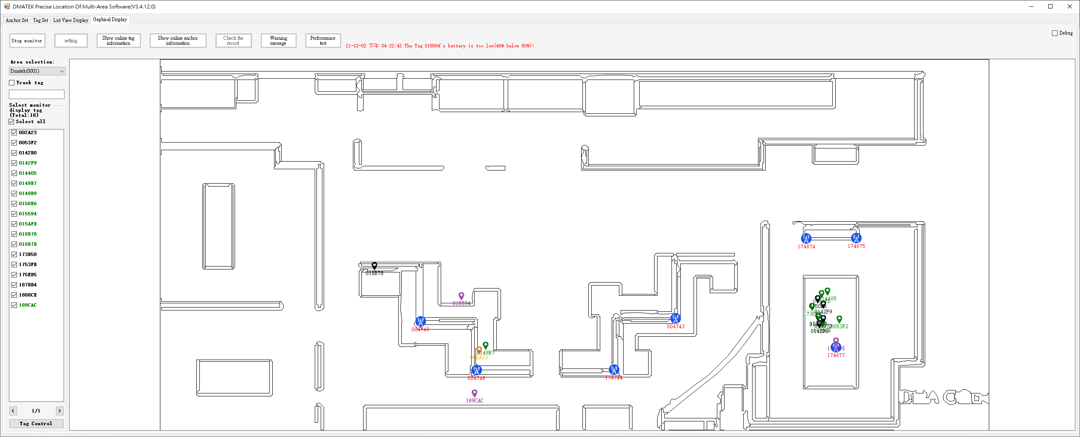
Gaphical Display

Slide 8
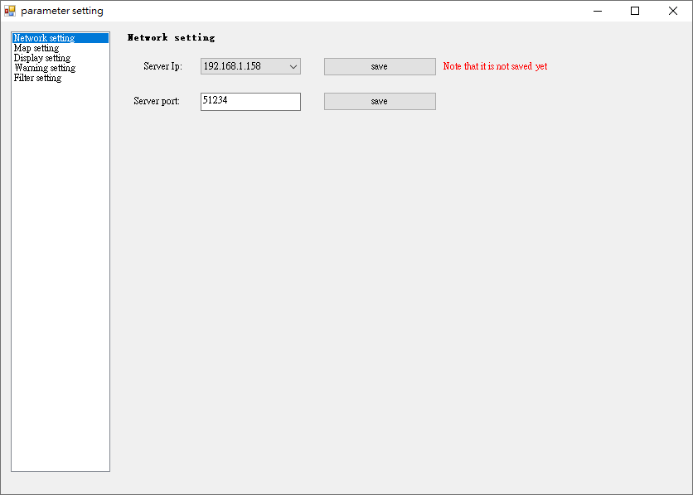
Network Setting

Slide 9
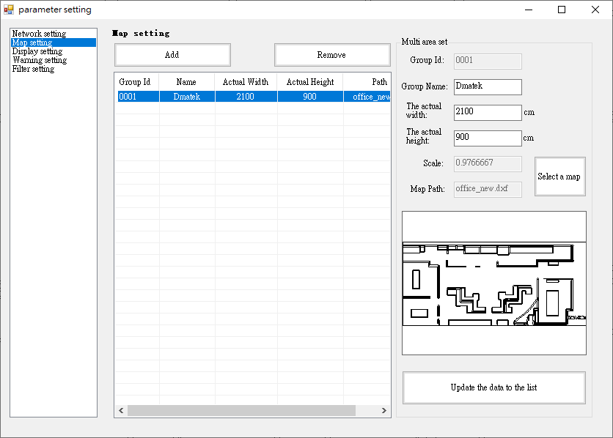
Map Setting

Slide 10
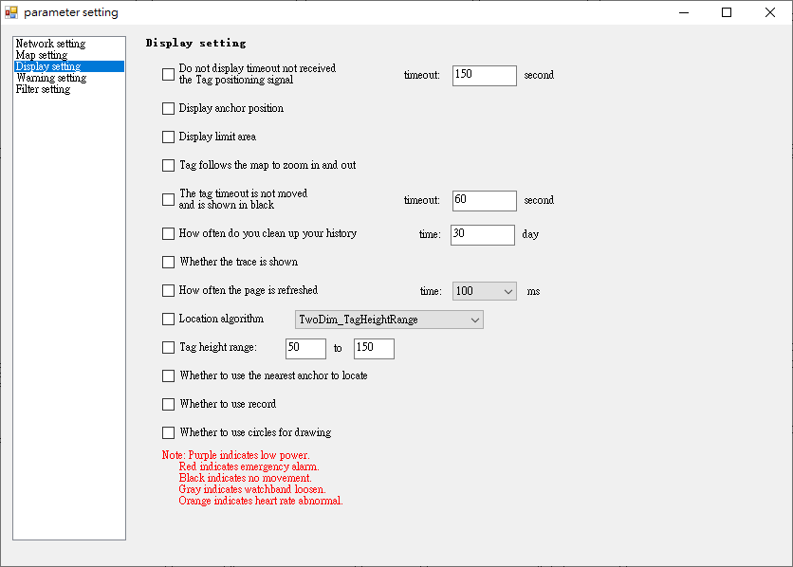
Display Setting

Slide 11
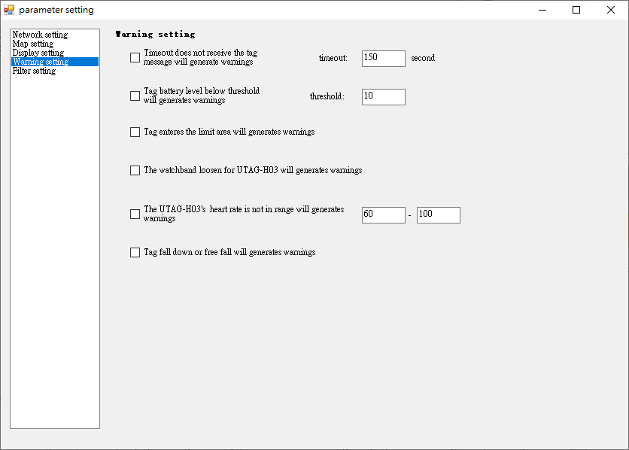
Warning Setting

Slide 12
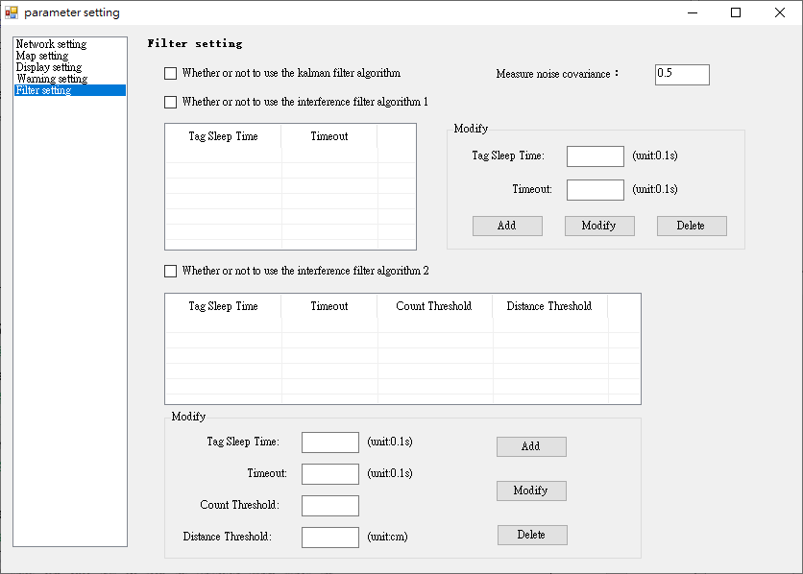
Filter Setting

Slide 13
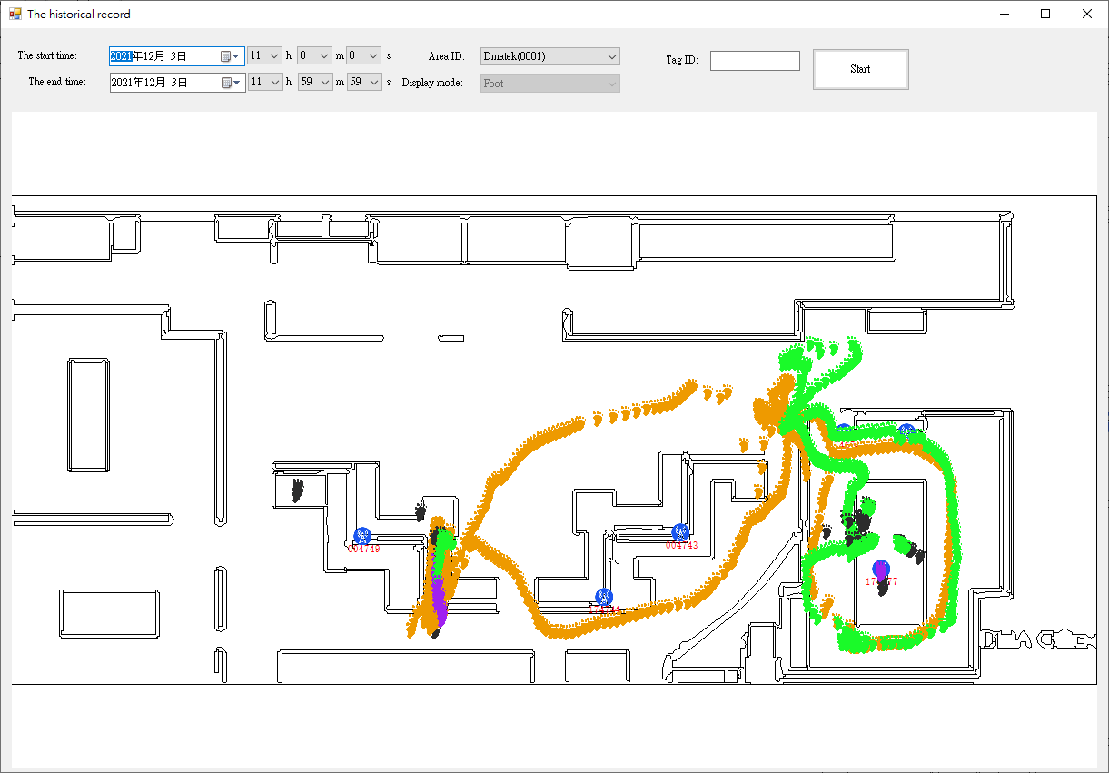
Historical Record

Slide 14
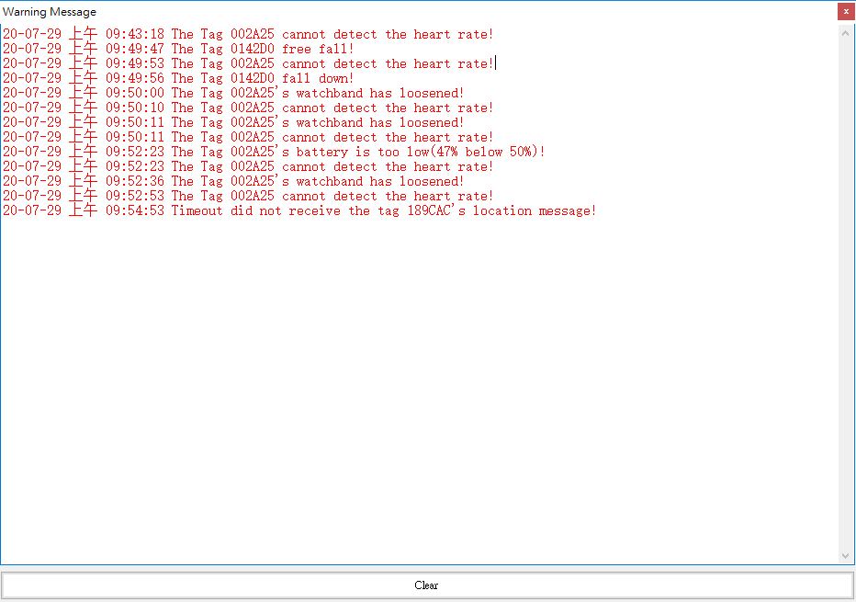
Warming Message

Slide 15
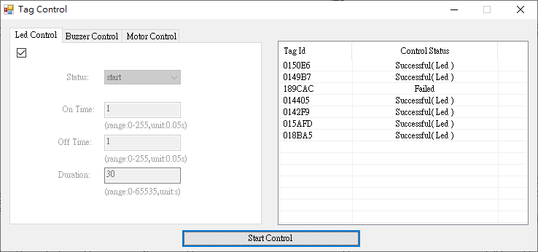
Device Control

Slide 16
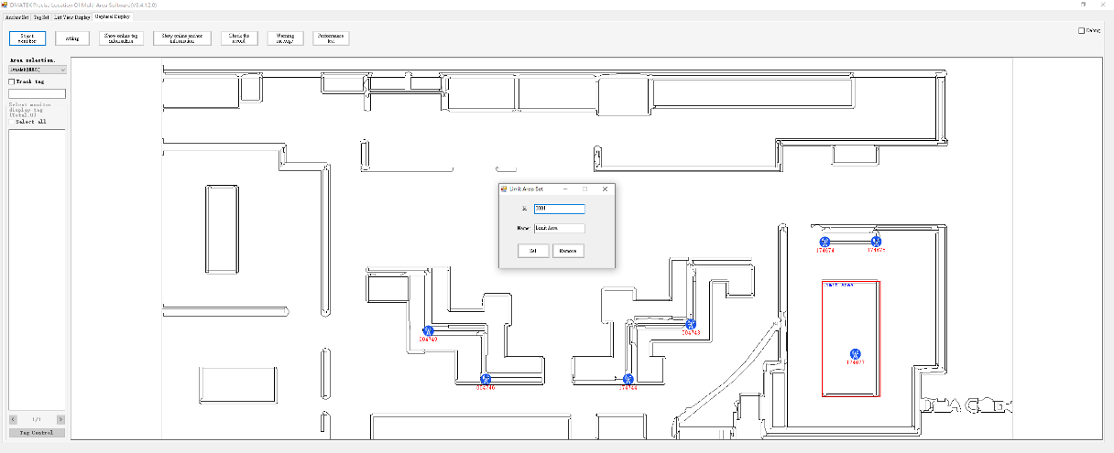
Restricted Area

