Slide 1
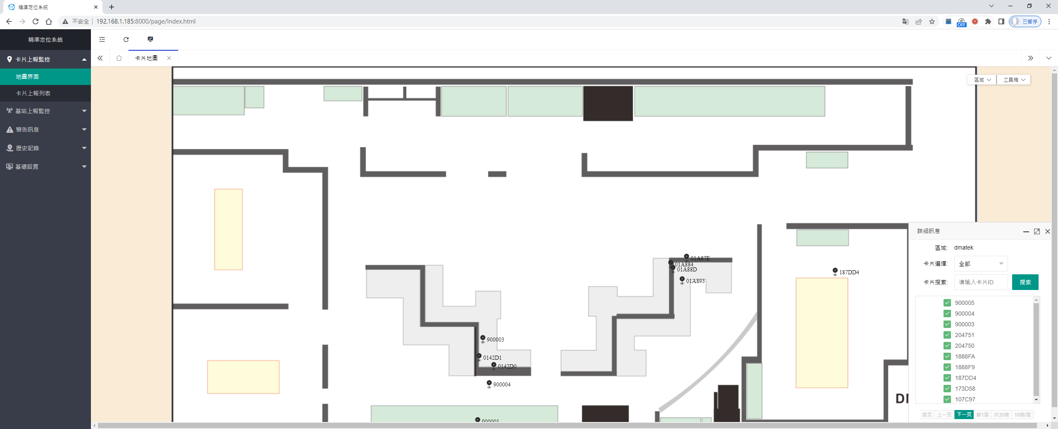
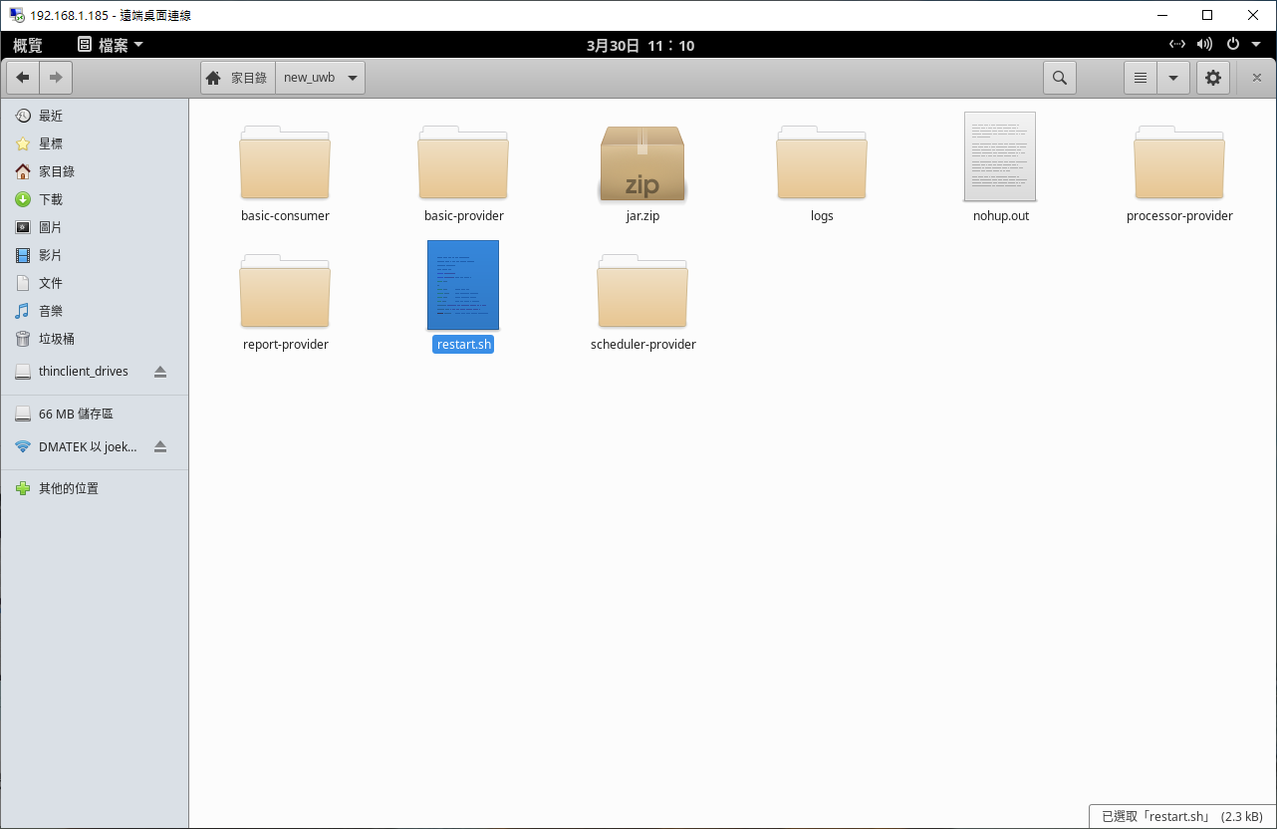
IPS Function
Execution Environment
Ubuntu System
Docker Platform
Install by yourself
Package service installation
IPS web jar execution
Assistance with Installation (charge)
Main Function
IPS UDP Packet Monitoring
Real-time Location Display
Device Information
Warning Information
Historical Record
Backup Function
Source Code
none
Secondary Development
Provide HTTP API
No development platform restrictions
Usage Restrictions
Unlimited

Slide 2
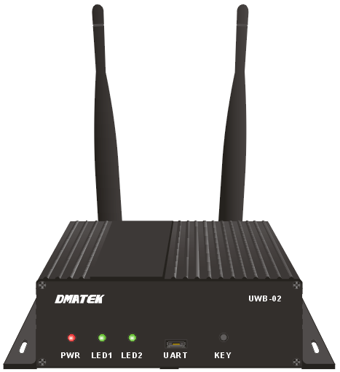
IPS Architecture
Third-party positioning web application development
Backup Server
UWB IPS Web
Backup Service (JAR)
backup-dubbo-provider
Location Services (JAR)
basic-dubbo-consumer
basic-dubbo-provider
processor-dubbo-provider
report-dubbo-provider
scheduler-dubbo-provider
Web Socket
image
mongo
nacos
UWB IPS
UWB IPS Web
real-time location display
device information
warning information
historical record
Internet
HTTP API
Package Service
Docker platform
Database(MongoDB)
Time series database(InfluxDB)
Key-value database(Redis)
Configuration management service(nacos)
Distributed coordination service(ZooKeeper)

Slide 3
Positioning Web Display

Slide 4
Real-time Location Display

Slide 5
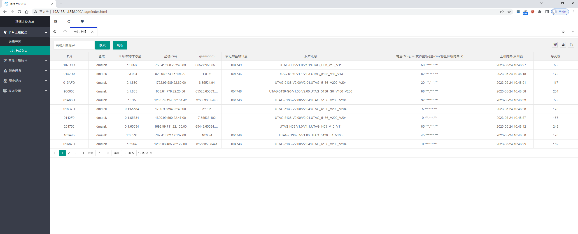
Device Information - Tag

Slide 6
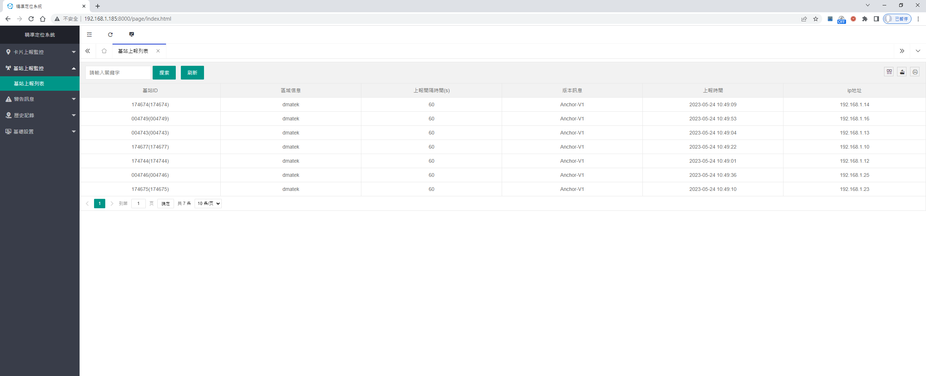
Device Information - Anchor

Slide 7
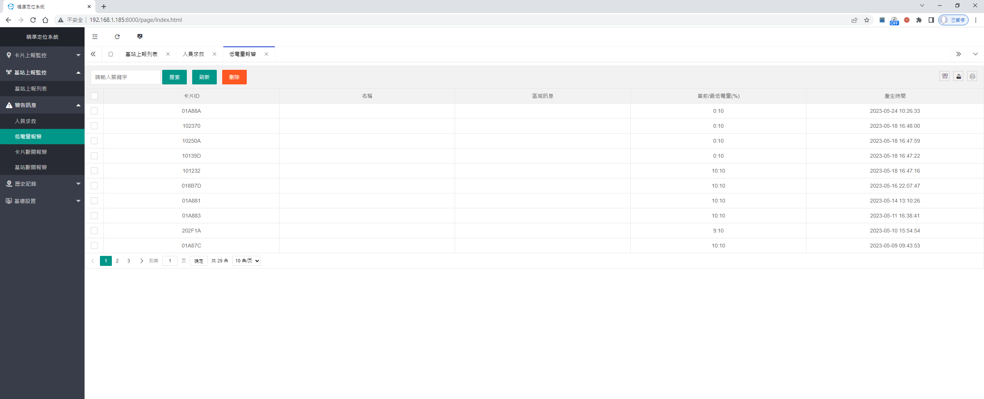
Warning Information

Slide 8
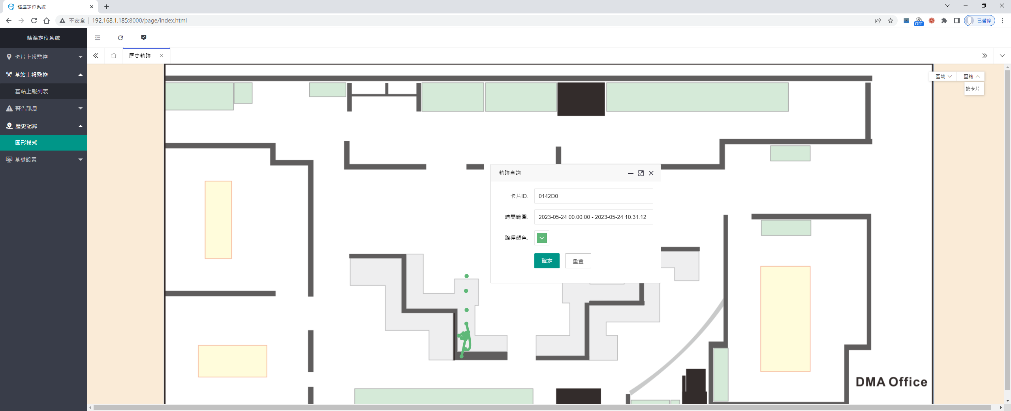
Historical Record

Slide 9
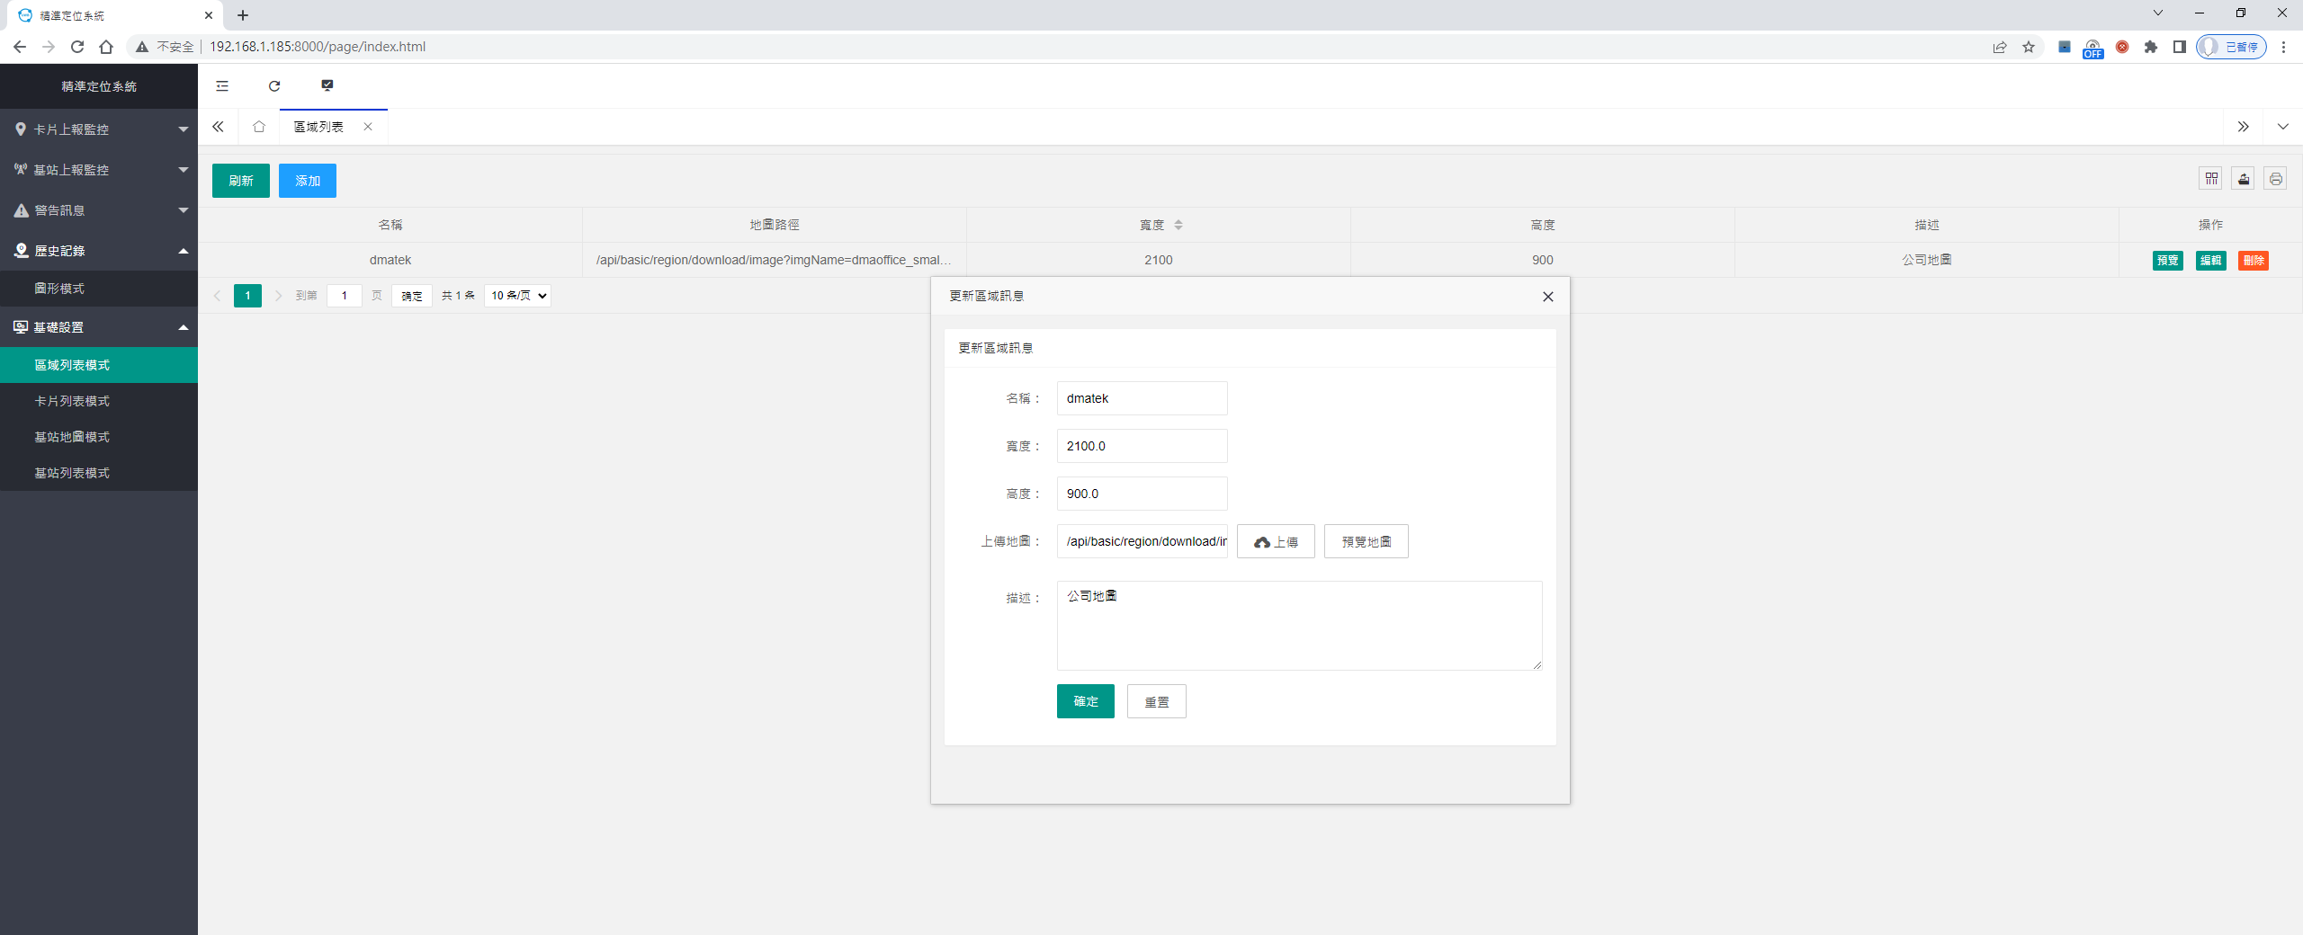
Settings - Map Setting

Slide 10
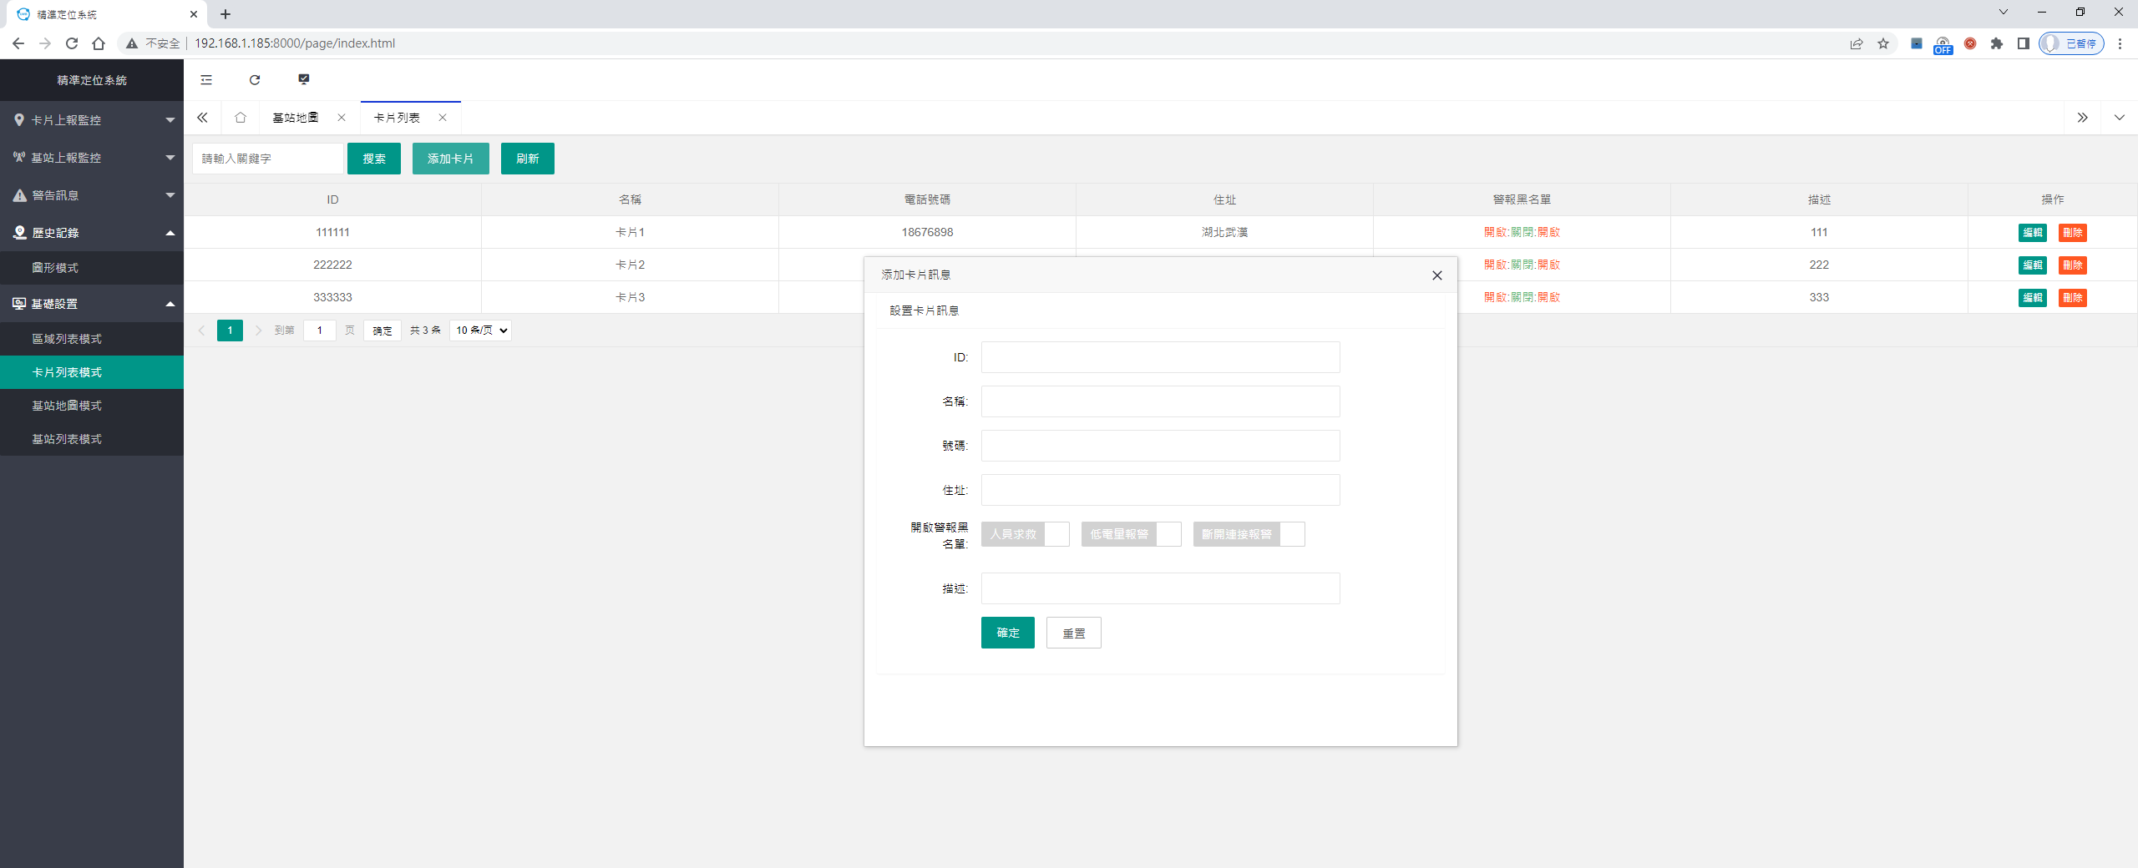
Settings - Tag Setting

Slide 11
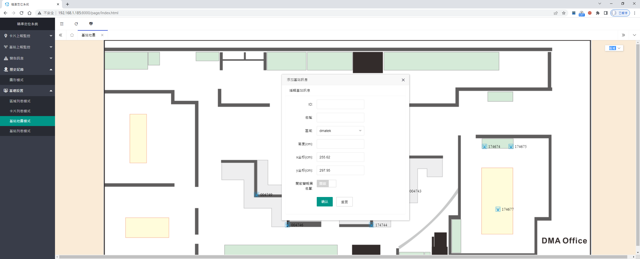
Settings - Anchor Graphics Setting

Slide 12
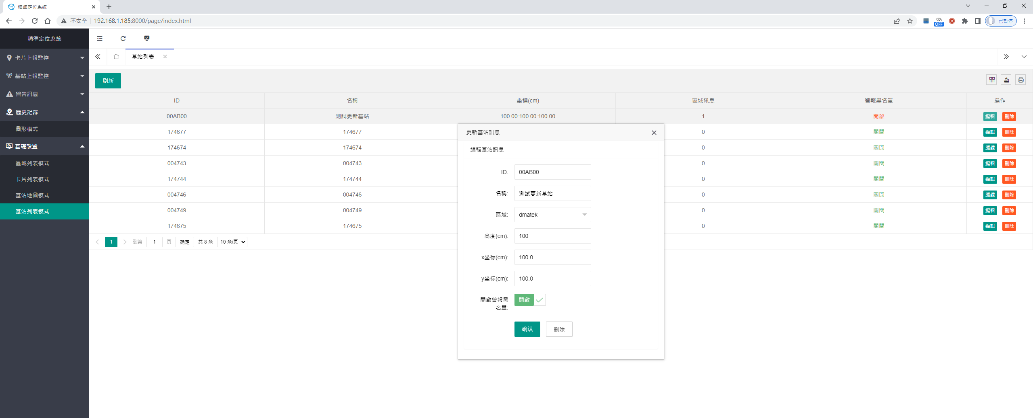
Settings - Anchor List Editing

Slide 13
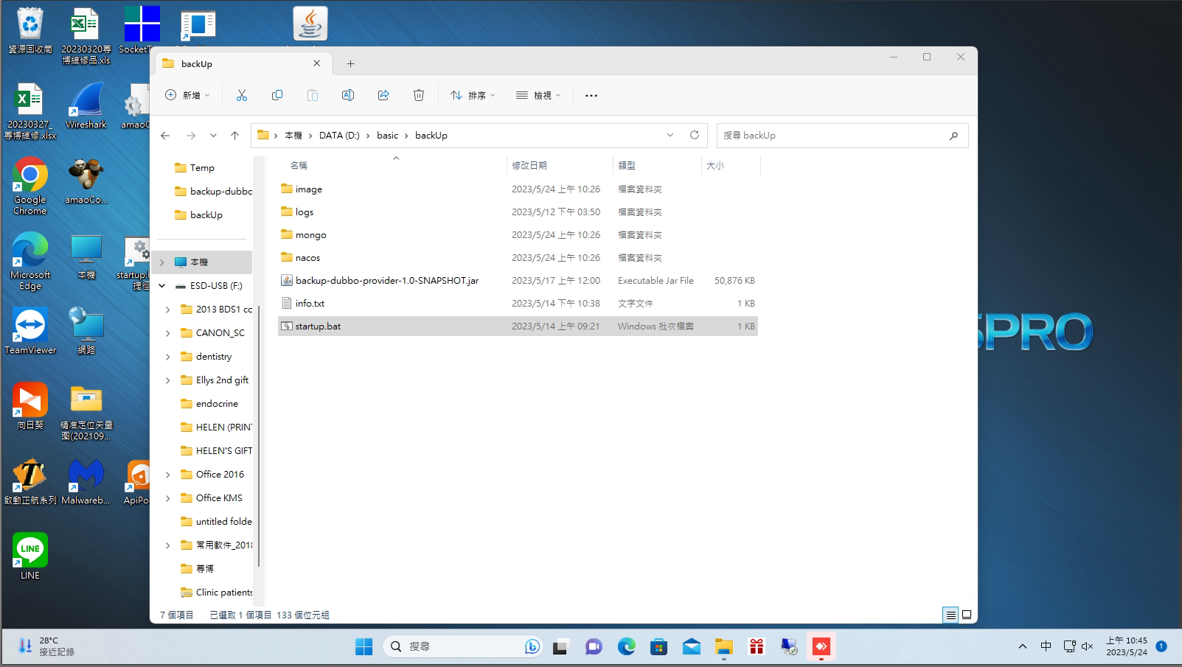
Backup Function

